Slide 1
Exception Handling
An exception can occur for many different reasons:
A user has entered an invalid data.
A file that needs to be opened cannot be found.
A network connection has been lost in the middle of communications or the JVM has run out of memory.
Exception handling
a mechanism to handle runtime errors such as ClassNotFound, IO, SQL, Remote etc.
Notes:
1> Some of these exceptions are caused by user error, others by programmer error, and others by physical resources that have failed in some manner.

Slide 2
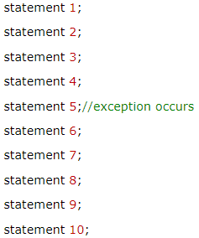
Advantage of Exception Handling
The core advantage of exception handling is to maintain the normal flow of the application.
Exception normally disrupts the normal flow of the application that is why, exception handling is used
E.g.

Slide 3
Exception Hierarchy
All exception classes are subtypes of the java.lang.Exception class.
The exception class is a subclass of the Throwable class.

Slide 4
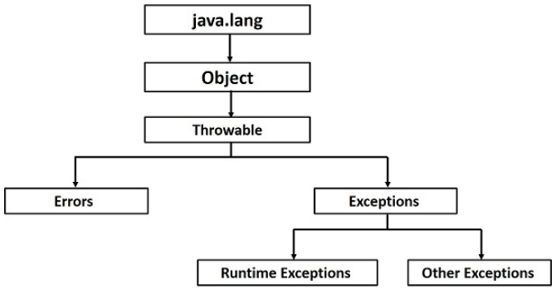
Exception Hierarchy
Notes:
The Object class is the parent class of all the classes in java by default. In other words, it is the topmost class of java.

Slide 5
Checked & Unchecked Exception
Checked Exceptions are exceptions that are checked by the compiler during the compilation of the program.
An example of a Checked Exception is the FileNotFoundException, which occurs during file handling in a Java program when the path of the file is invalid. This is a common cause of FileNotFoundException during compilation of a Java program.

Slide 6
Unchecked Exceptions
Runtime Exceptions are known as unchecked exceptions. These are exceptions that occur during the runtime of the java program.
These exceptions are not checked at compile time which means even if your program is giving an unchecked exception and even if you are not handling it, the program will not give a compilation error. These exceptions occur mainly from the programmer’s side during the run time of the program.
Let’s take a real-time example to understand the unchecked exception in java:
A real-life example of an unchecked exception in Java is when you try to divide a number by zero. This will result in an ArithmeticException at runtime, which is an unchecked exception.
For example, imagine you are writing a program to calculate the average of some numbers, and you accidentally divide by zero because you forgot to check for zero values.
The program will compile without any errors, but when you run it, it will throw an ArithmeticException because dividing by zero is not allowed.

Slide 7
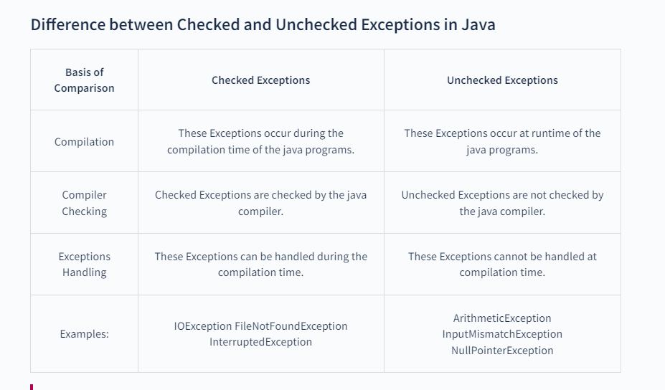
Notes:
IOException is a checked exception in Java that indicates a problem while performing Input/Output (I/O) operations. This usually happens when a failure occurs while performing read, write or search operations in files or directories

Slide 8
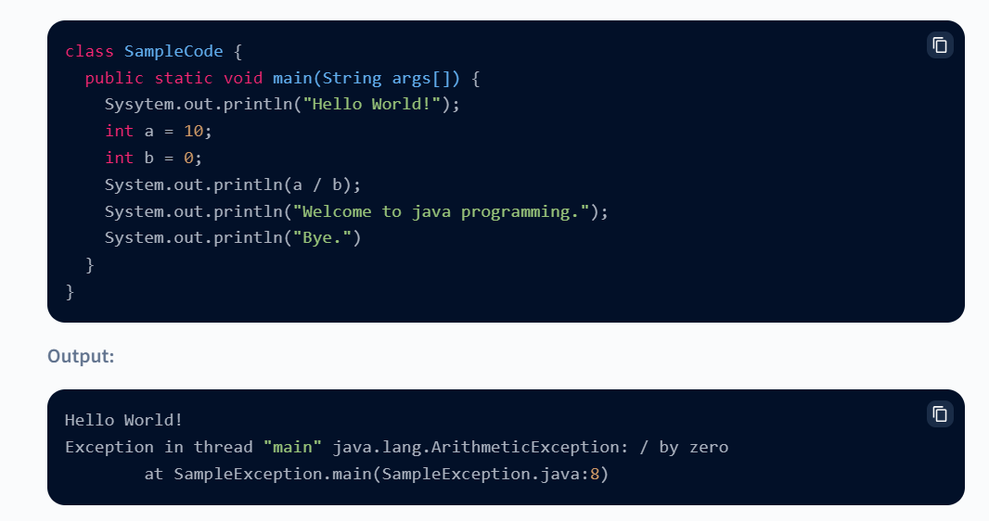
Exceptions Not handled

Slide 9
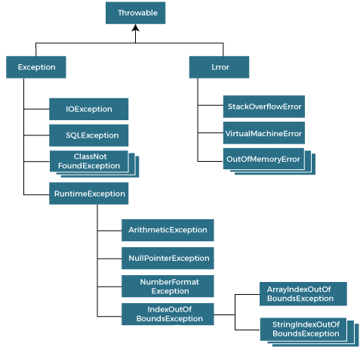
Summarized Exception Hierarchy

Slide 10
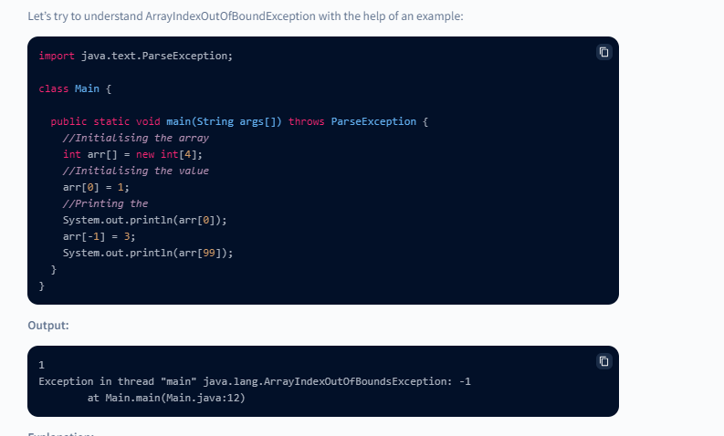
Runtime Exceptions
ArrayIndexOutOfBoundsException
ArrayIndexOutOfBoundsException is an unchecked exception in Java that occurs when an attempt is made to access an array element at an invalid index
.The index can be either negative or greater than or equal to the size of the array.
For example, if an array has 5 elements, trying to access the 6th element will result in an ArrayIndexOutOfBoundsException.

Slide 11
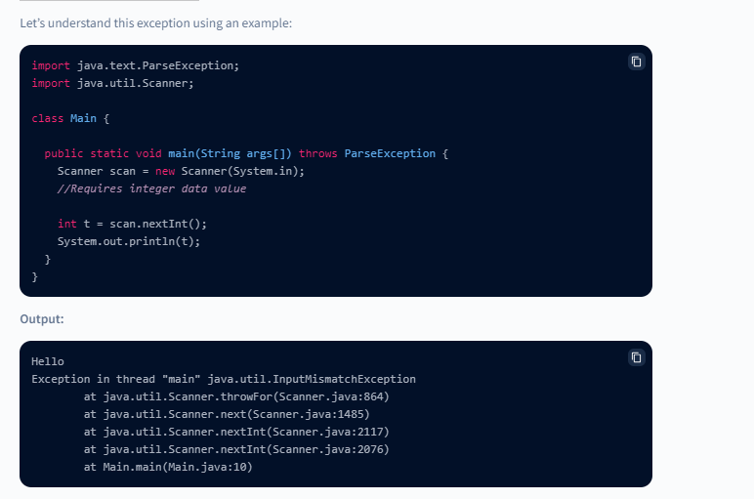
Runtime Exceptions
InputMismatchException
InputMismatchException is a type of unchecked exception in Java, which is thrown when a program tries to read data of a different type than what is expected. For example, if the program expects an integer input but the user enters a string, this exception can be thrown. This exception is commonly encountered when using the Scanner class to read input from the user.

Slide 12
Java Exception Handling Keywords
There are 5 keywords used in java exception handling.
try
catch
finally
throw
throws

Slide 13
try-catch
Java try block
Java try block is used to enclose the code that might throw an exception.
Java try block must be followed by either catch or finally block.
Java catch block
Java catch block is used to handle the Exception.
It must be used after the try block only.

Slide 14
try-catch
Syntax of java try-catch
try{
//code that may throw exception
}catch(Exception_class_Name ref){ }
Syntax of try-finally block
try{
//code that may throw exception
}finally{ }

Slide 15

Problem without exception handling
if we don't use try-catch block, it will throw exception and code after exception will not be executed.

Slide 16
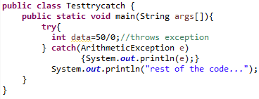

Solution
Now, rest of the code will executed i.e. rest of the code... statement is printed.

Slide 17
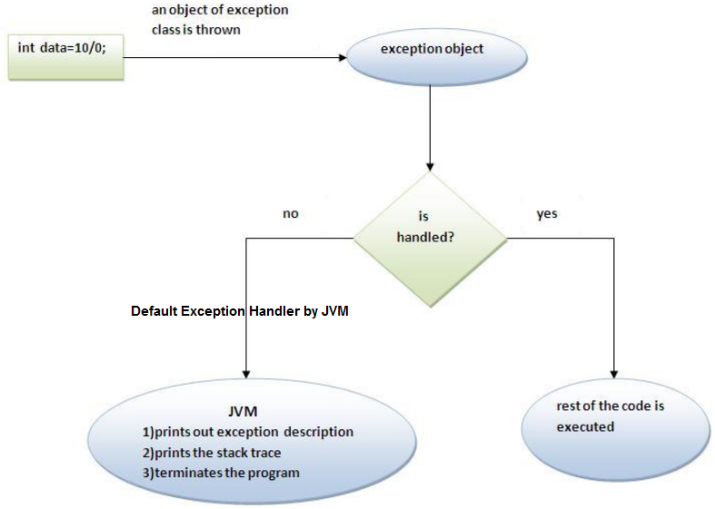
Internal working of try-catch block

Slide 18
catch multiple exceptions
multiple catch blocks can be used with a single try.
If we want to perform different tasks at the occurrence of different Exceptions, java multi catch block is used.
Syntax:
try { // Protected code }
catch (ExceptionType1 e1) {// Catch block }
catch (ExceptionType2 e2) {// Catch block }
catch (ExceptionType3 e3) {// Catch block }

Slide 19
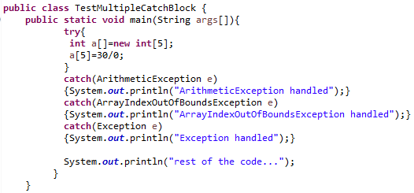

Example

Slide 20
Rules for Multi-catch block
Rule:
At a time only one Exception is occurred and at a time only one catch block is executed.
Rule:
All catch blocks must be ordered from most specific to most general i.e. catch for ArithmeticException must come before catch for Exception .

Slide 21
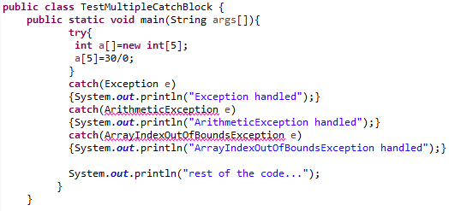
Example
Notes:
Compile-time error
Rule 2: example

Slide 22
finally block
Java finally block is always executed whether exception is handled or not.
Java finally block follows try or catch block.
Why use java finally?
Finally block in java can be used to put "cleanup" code such as closing a file, closing connection etc.
Syntax:
try { // Protected code }
catch (ExceptionType1 e1) {// Catch block }
catch (ExceptionType2 e2) {// Catch block }
finally {// finally block always executes}

Slide 23
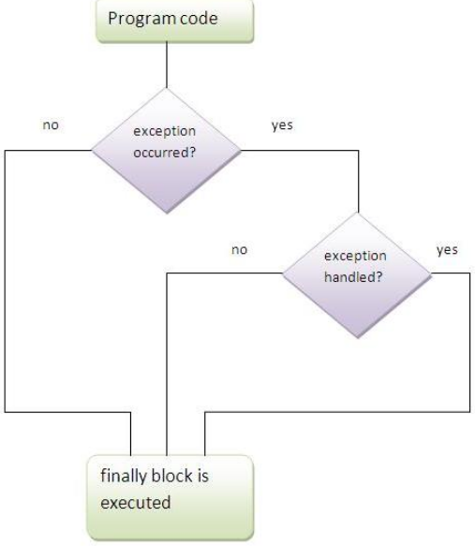
Internal Working
Note: If you don't handle exception, before terminating the program, JVM executes finally block(if any).
2
1
3

Slide 24
Usage of Java finally
Different cases where java finally block can be used:
Case 1 : exception doesn't occur
Case 2 : exception occurs and not handled
Case 3 : exception occurs and handled
Rule:
For each try block there can be zero or more catch blocks, but only one finally block.

Slide 25
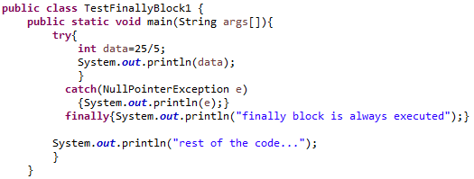

Case 1 : exception doesn't occur
Output:

Slide 26
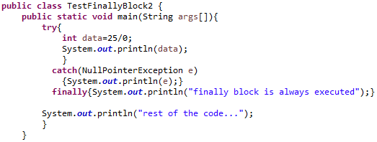
Case 2 : exception occurs and not handled
Output:

Slide 27
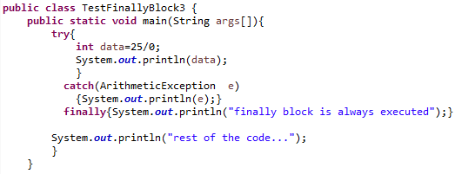

Case 3 : exception occurs and handled
Output:

Slide 28
Java throw exception
throw keyword is used to explicitly throw an exception (either checked or un-checked exception)
mainly used to throw custom exception
Syntax:
throw exception;
example of throw IOException.
throw new IOException("sorry device error);

Slide 29
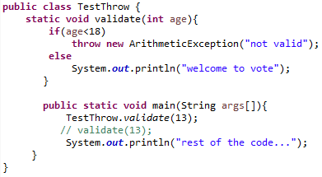

Example
Output:

Slide 30
Java throws keyword
throws keyword is used to declare an exception
If a method does not handle a checked exception, the method must declare it using throws keyword
The throws keyword appears at the end of a method's signature.
Basically used to postpone the handling of a checked exception
declare the exceptions in the method signature using throws and handle the exceptions where you are calling this method by using try-catch.
The calling method is forced to handle declared exceptions
Notes:
Generally, throws is used to postpone the handling of a checked exception and throw is used to invoke an exception explicitly.

Slide 31
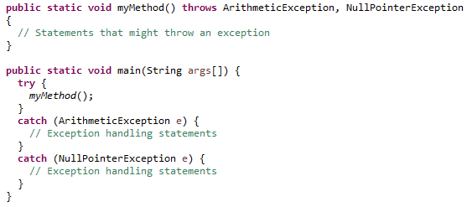
Java throws keyword
By using throws we can declare multiple exceptions in one go

Slide 32
Difference between throw and throws
throw keyword is used to explicitly throw an exception.
Checked exception cannot be propagated using throw only.
Followed by an instance
used within the method.
cannot throw multiple exceptions
throws keyword is used to declare an exception.
Checked exception can be propagated with throws.
Followed by class
with the method signature.
can declare multiple exceptions e.g. public void method()throws IOException,SQLException
throw
throws

Slide 33
Questions?

